Slide 1


Intelligent Systems in Gaming
By Andy Lopez

Slide 2

What is an Intelligent System?
Advanced computer algorithm that gathers, analyzes, and responds to the data it collects.
Amazon.com and its Intelligent System monitors your day-to-day habits.

Slide 3

Intelligent System in Gaming
$200-billion-dollar industry
Videogame makers such as Activision Blizzard and Rockstar utilize Intelligent Systems
The business proposal of SBMM

Slide 4
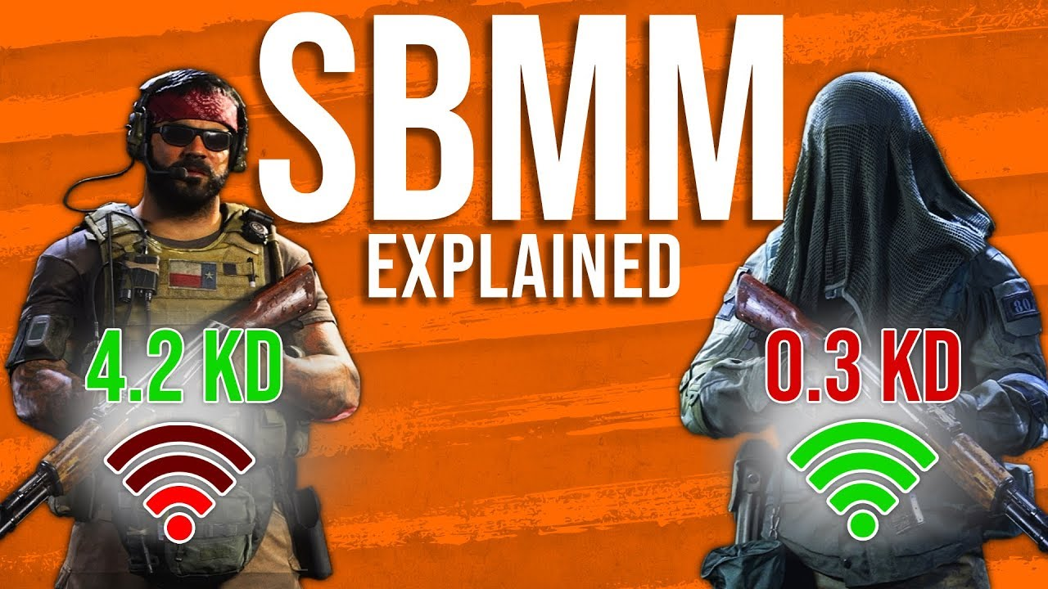
Skill-Based Matchmaking. One of the primary Intelligent Systems in Online-Gaming.
Intelligence-based program that learns what sort of player you categorize under.
Are you a high-skill or low-skilled player?
How many hours do you play each day?

Slide 5

Examples of Skill-Based Matchmaking in video-games
The highest-selling videogame franchise in history.
Close to 100 Million concurrent players during 2020.
$5.1 Billion in Microtransaction Revenue in Q4 of 2021

Slide 6

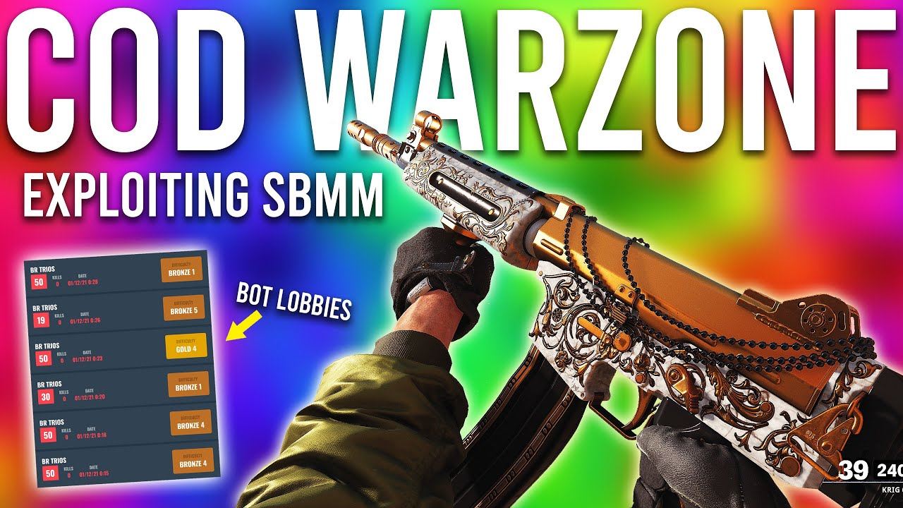
The Future of Intelligent Systems in Video Games
SBMM is here to stay
High-skilled players will continue to voice their opinions on the topic.
Companies will cater to casual players
Change will happen if enough people voice their opinions.

Slide 7
Quick Question
Has anyone experienced Skill-Based Matchmaking in their online-video game? How do you feel about the topic?

Slide 8

Any Questions?

Slide 9
Thank You!

Slide 10
References
https://investor.activision.com/news-releases/news-release-details/activision-blizzard-announces-fourth-quarter-and-2021-financial
https://dotesports.com/call-of-duty/news/does-the-modern-warfare-2-have-skill-based-matchmaking-sbmm

